Slide 1
Things to consider : user interactive, web viz, 3D, spatial data, scalability, robustness, speed, customizability, user adoption, ease of use.
SHOW (legend w/ color dots ?)
Dynamic
Price
Handling spatial data
Adoption
Customizability
user interactive: web viz ?
spatial data`
3D
scalability
robustness
speed
* user interactivity
$$ : commercial
basemap
spatial data:
* user interactivity
$$ : commercial
SOFTWARES
LIBRARIES
Adoption
JAVASCRIPT
Leaflet
D3*
Raw
Processing*
FusionCharts
Dc.js
Anychart*
ModestMap
Tableau
Chart*
crossfilter
QlickView
Dygraphs
Three^{3D}
Polychart
Highchart$$ highmaps$$
Zingchart$$
Spotfire
Mondrian
Amcharts
Plot.ly
ArcGIS
PYTHON
animint
R
MS BI Stack
rCharts
QGIS
Datadesk
matplotlib
ggplot
GGobi
Xmdv Tools
Bokeh
ggplot2
basemap
Shiny*
InstantAtlas
ggmap
OpenDX
geopandas
ggvis*
Customizability
Notes:
EXPLORING SOME DATA VIZ TOOLS
not exhaustive nor exact, qualitative
D3 : steep learning curve, but ☺ for complex interactive
CONSIDER:
dynamic
user interactive: web viz ?
spatial data,
robustness
performance :speed
http://techslides.com/50-javascript-charting-and-graphics-libraries

Slide 2
Things to consider : user interactive, web viz, 3D, spatial data, scalability, robustness, speed, customizability, user adoption, ease of use.
SHOW (legend w/ color dots ?)
Dynamic
Price
Handling spatial data
Adoption
Customizability
user interactive: web viz ?
spatial data`
3D
scalability
robustness
speed
* user interactivity
$$ : commercial
basemap
spatial data:
* user interactivity
$$ : commercial
SOFTWARES
LIBRARIES
Tableau
JAVASCRIPT
Leaflet
D3
QlickView
Raw
Chart
Zingchart
Processing
FusionCharts
Dc.js
Spotfire
Mondrian
crossfilter
Amcharts
Anychart
Dygraphs
ModestMap
ArcGIS
Highchart highmaps
Three
Polychart
MS BI Stack
QGIS
Plot.ly
PYTHON
animint
Datadesk
R
Xmdv Tools
rCharts
basemap
Bokeh
ggplot
InstantAtlas
matplotlib
ggplot2
GGobi
OpenDX
geopandas
ggmap
Shiny
ggvis
Customizability
Notes:
EXPLORING SOME DATA VIZ TOOLS
not exhaustive nor exact, qualitative
D3 : steep learning curve, but ☺ for complex interactive
CONSIDER:
dynamic
user interactive: web viz ?
spatial data,
robustness
performance :speed
http://techslides.com/50-javascript-charting-and-graphics-libraries

Slide 3
Modal portfolio
Percent agreement map
Footprint map

Slide 4
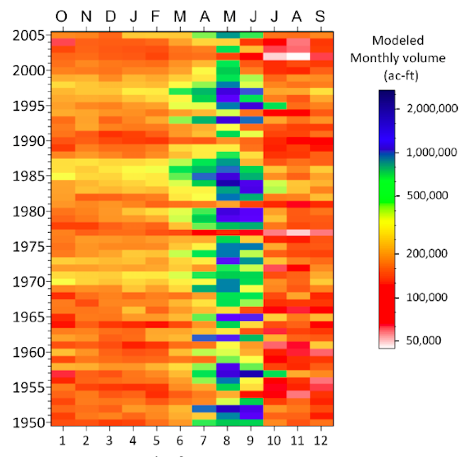
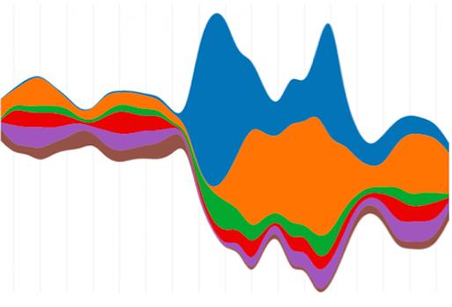
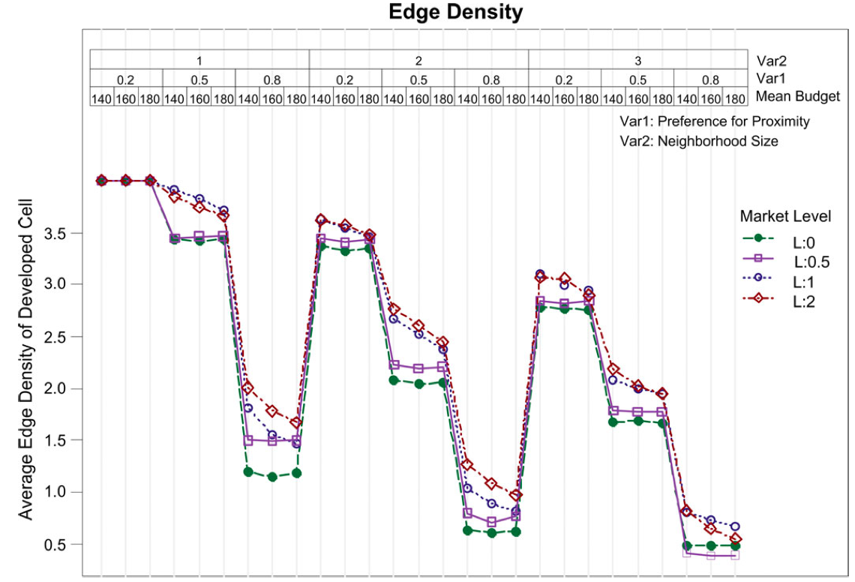
(a) Horizon graph
(b) Streamgraph
(c) Line graph
(d) Temporal map

Slide 5
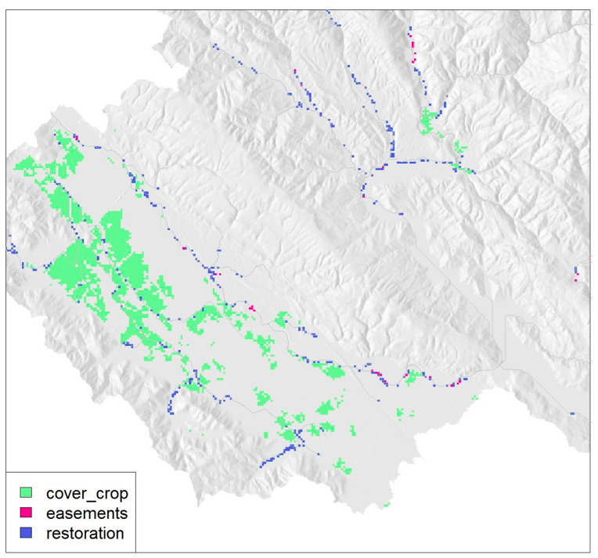
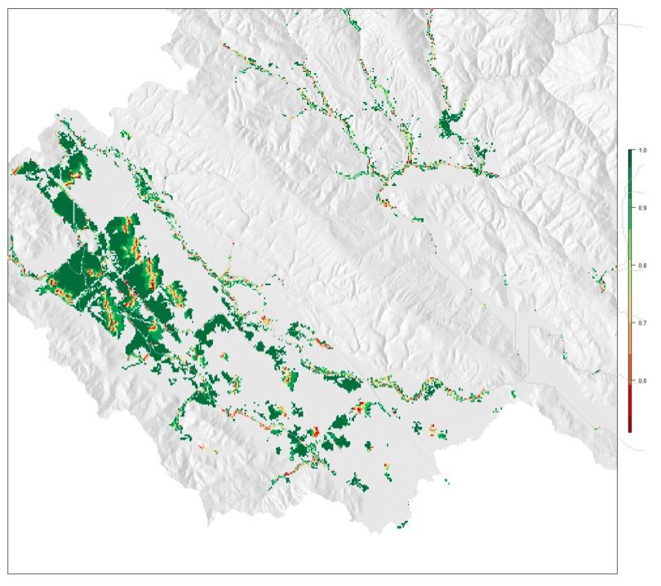
^{(a) Modal portfolio}
^{(b) Frequency map}

Slide 6
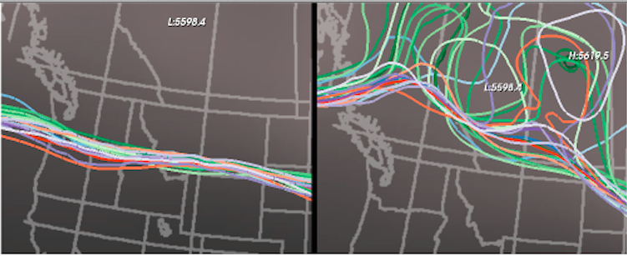
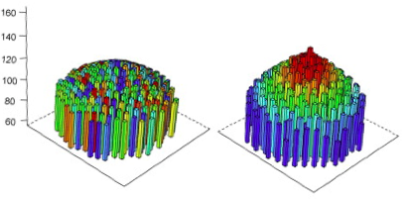
^{(a) Spaghetti plots}
^{(b) 3D histograms}

Slide 7
Tableau Gathering:
Comapre ES model outputs (maps): \ref{fig:coastal_2}

Slide 8
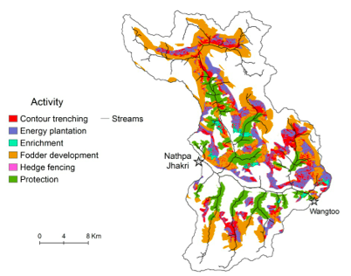
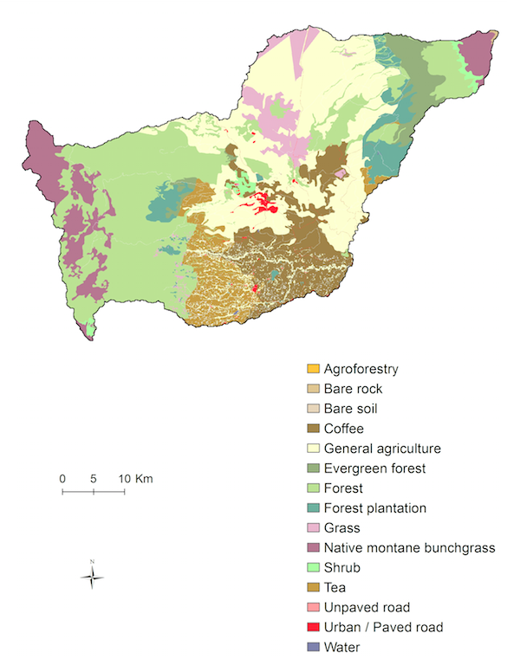
A portfolio map of the Nathpa Jhakri catchment [@Sadrian] A portfolio map of the Nathpa Jhakri catchment [@Sadrian]
(a) Portfolio map
(b) LULC map

Slide 9
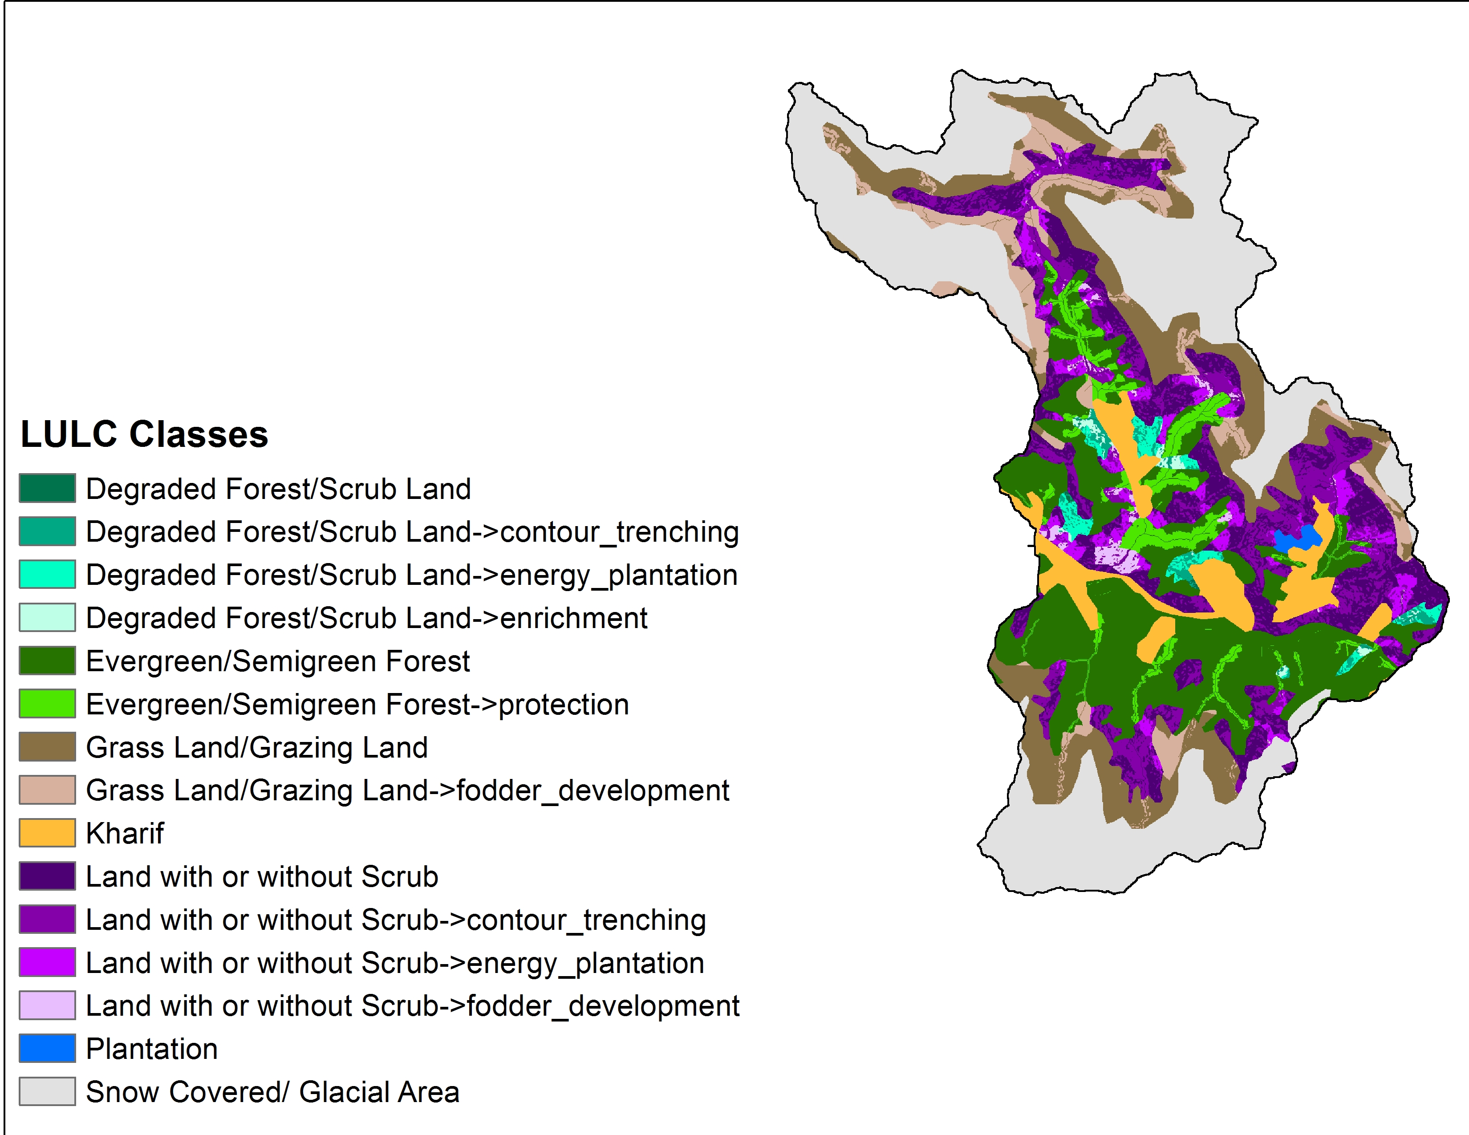
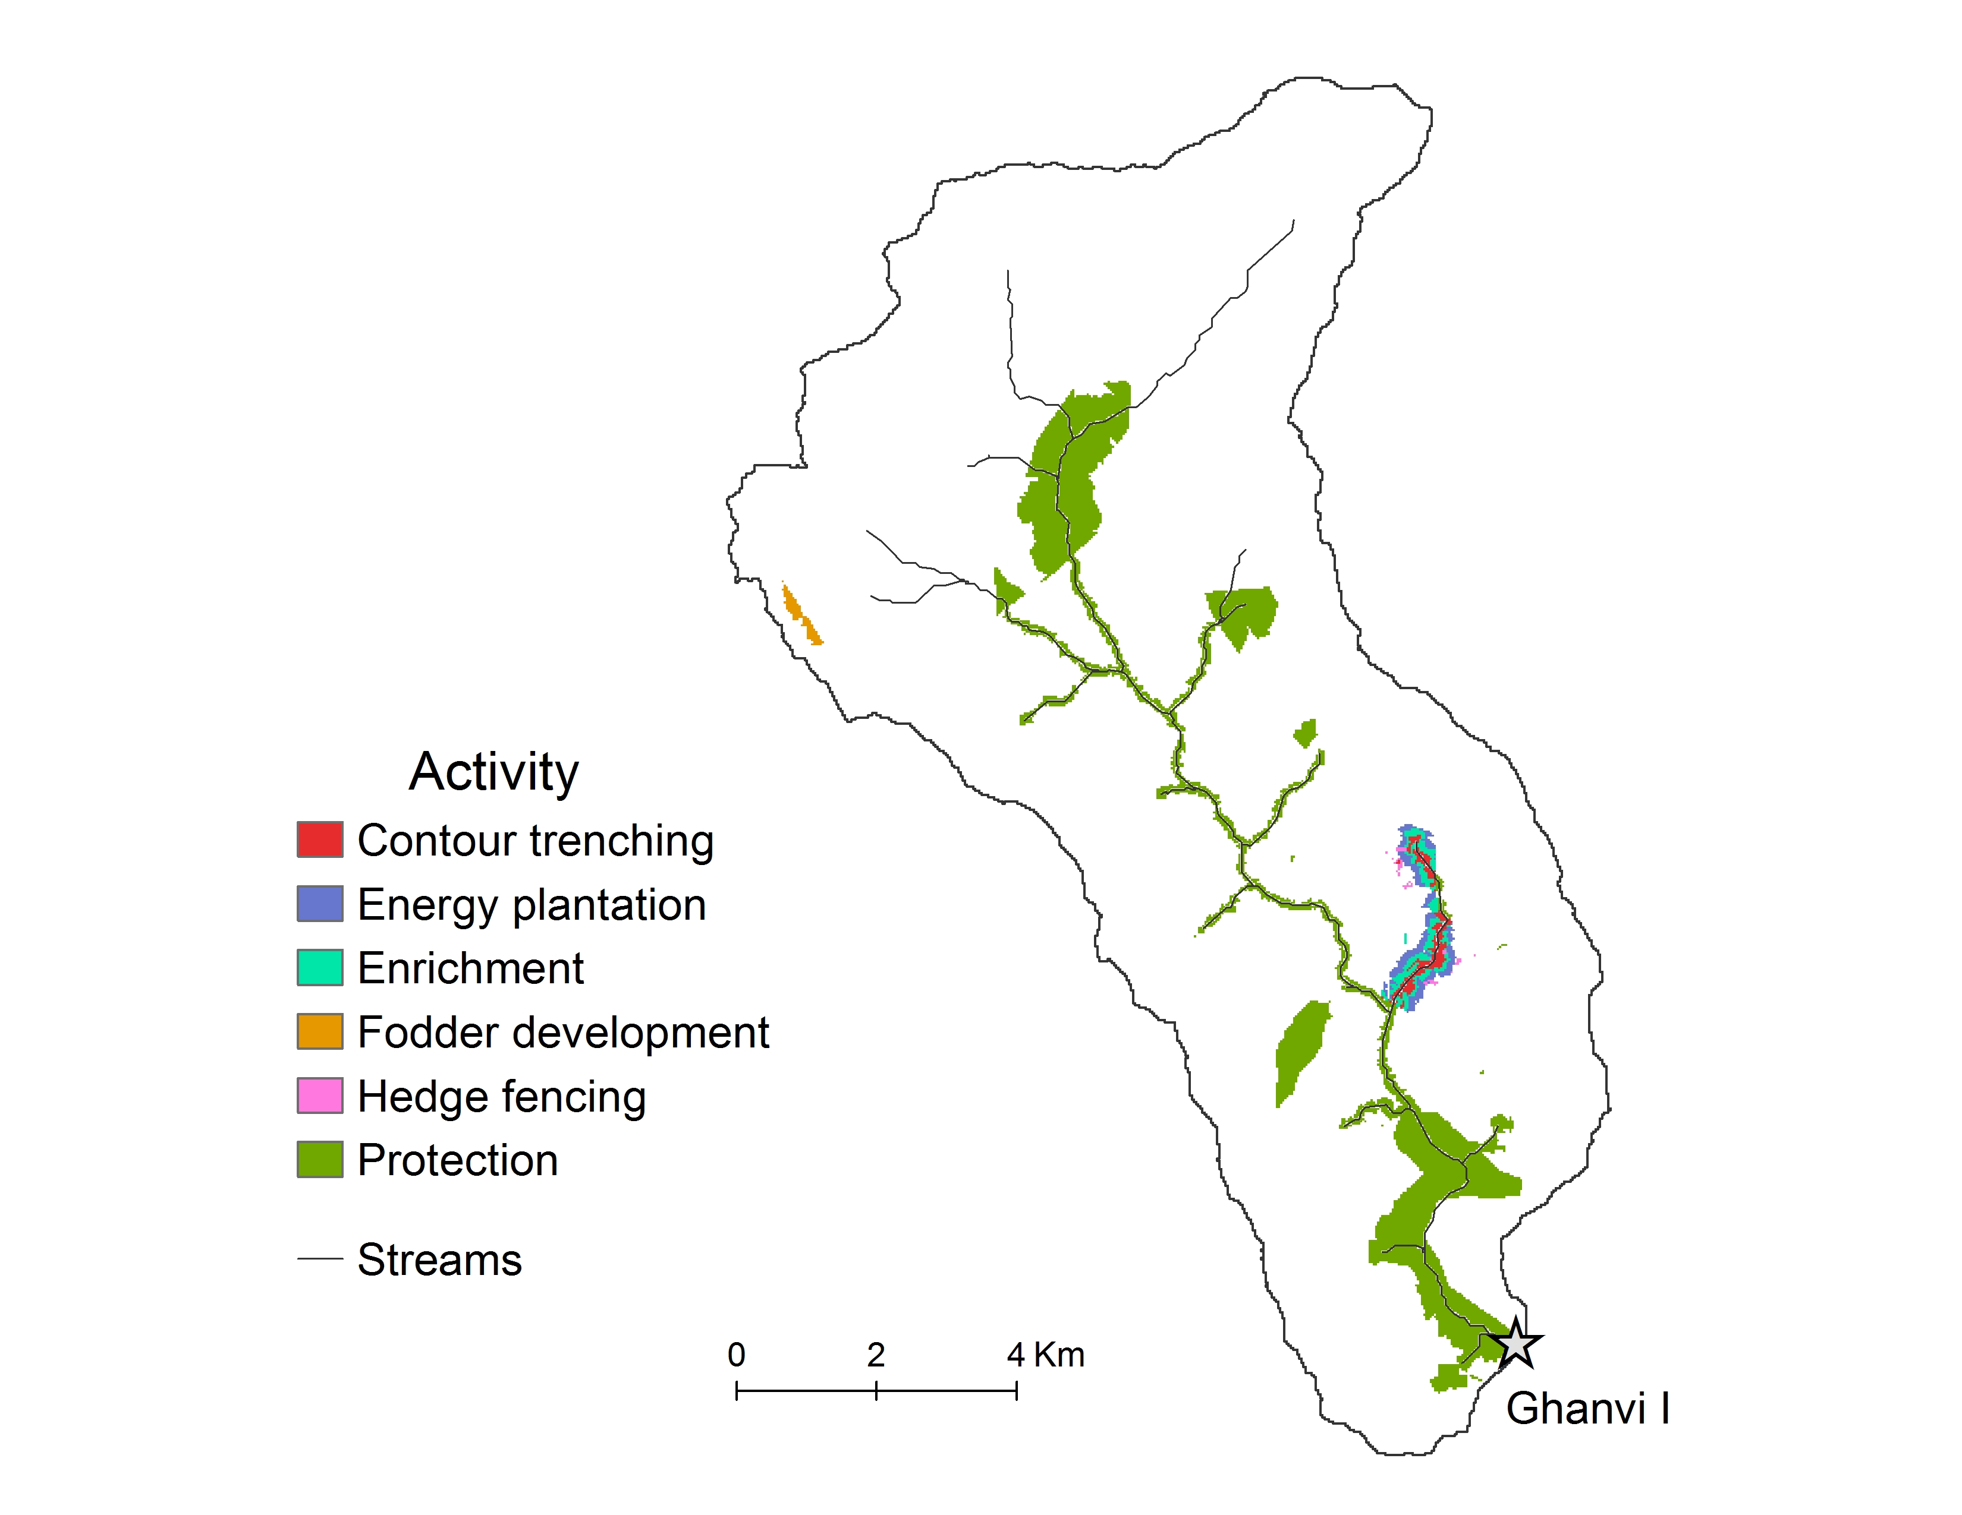
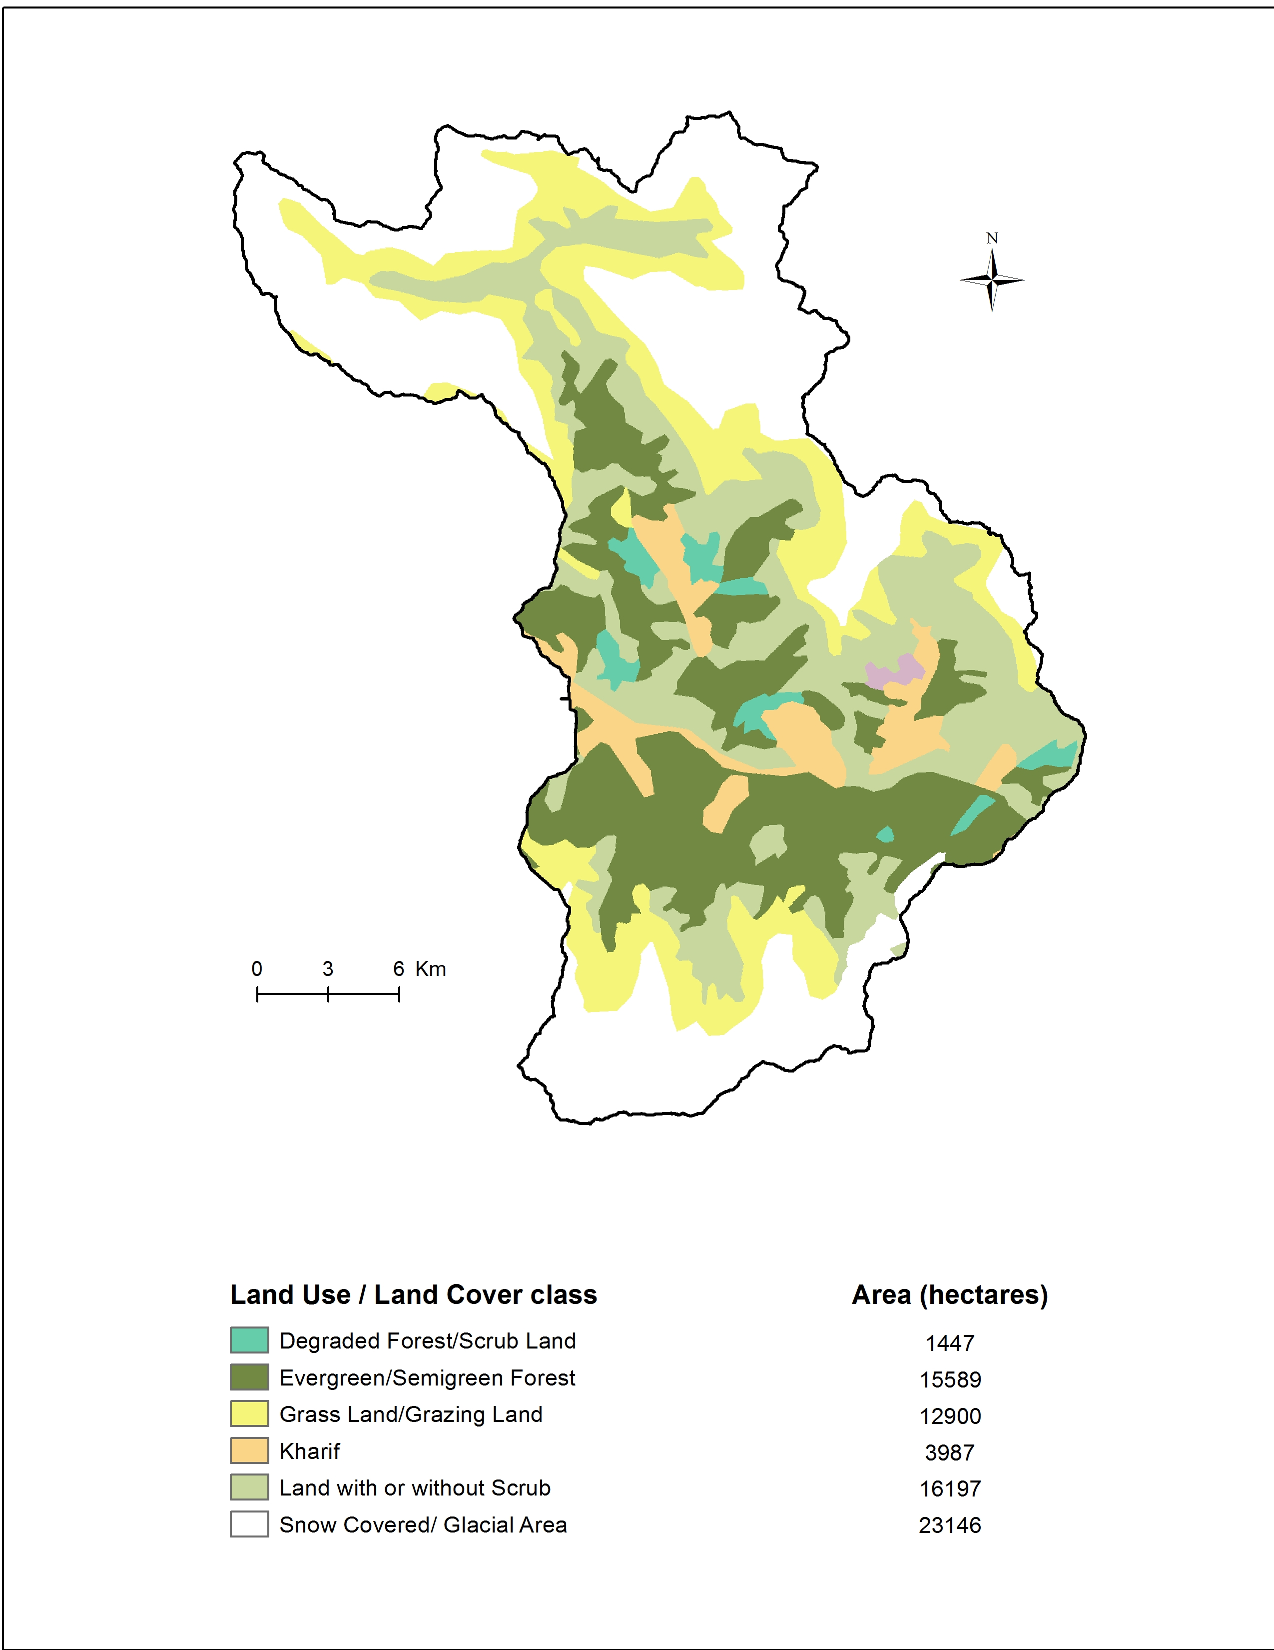
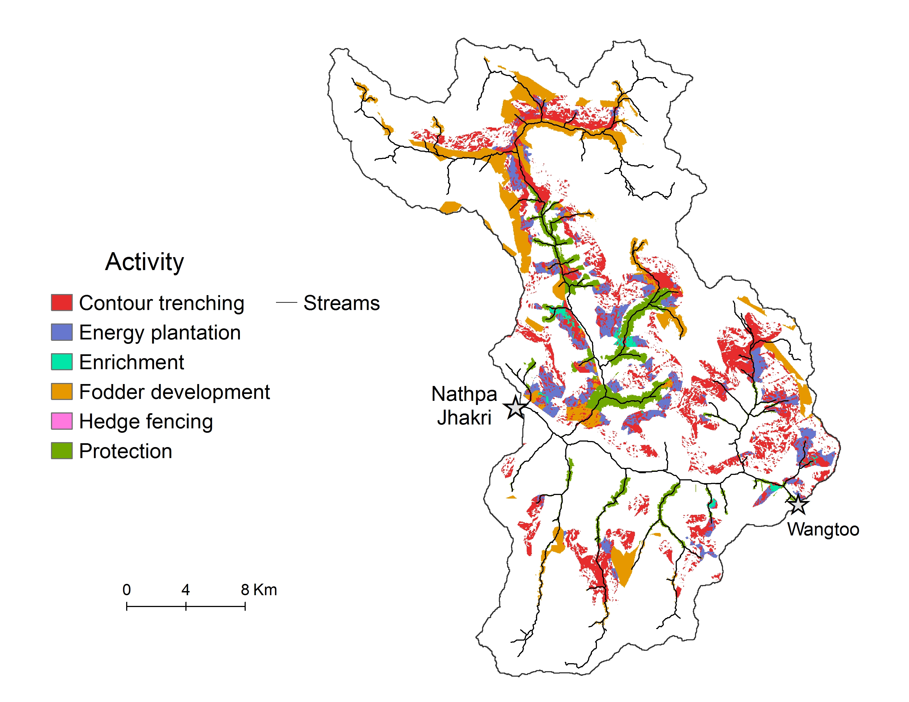
Rios activity portfolio
Nathpa jhakri, 15% budget
Nathpa
Jhakri
Wangtoo

Slide 10
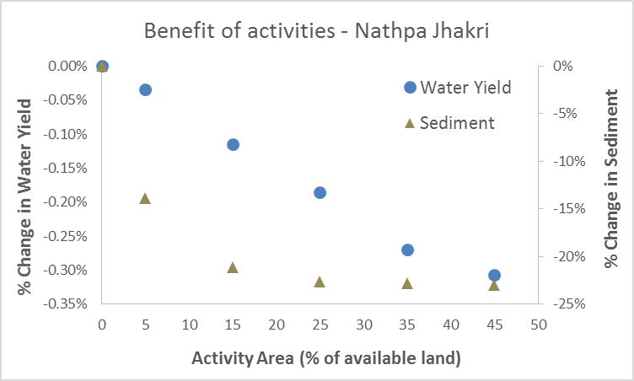
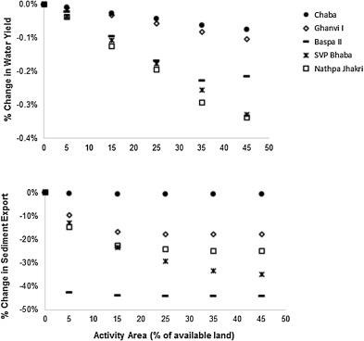
(a) Two axis scatterplot
(b) Two axis scatterplot Sadrian Each shape correspond to a specific watershed
Figure to come

Slide 11
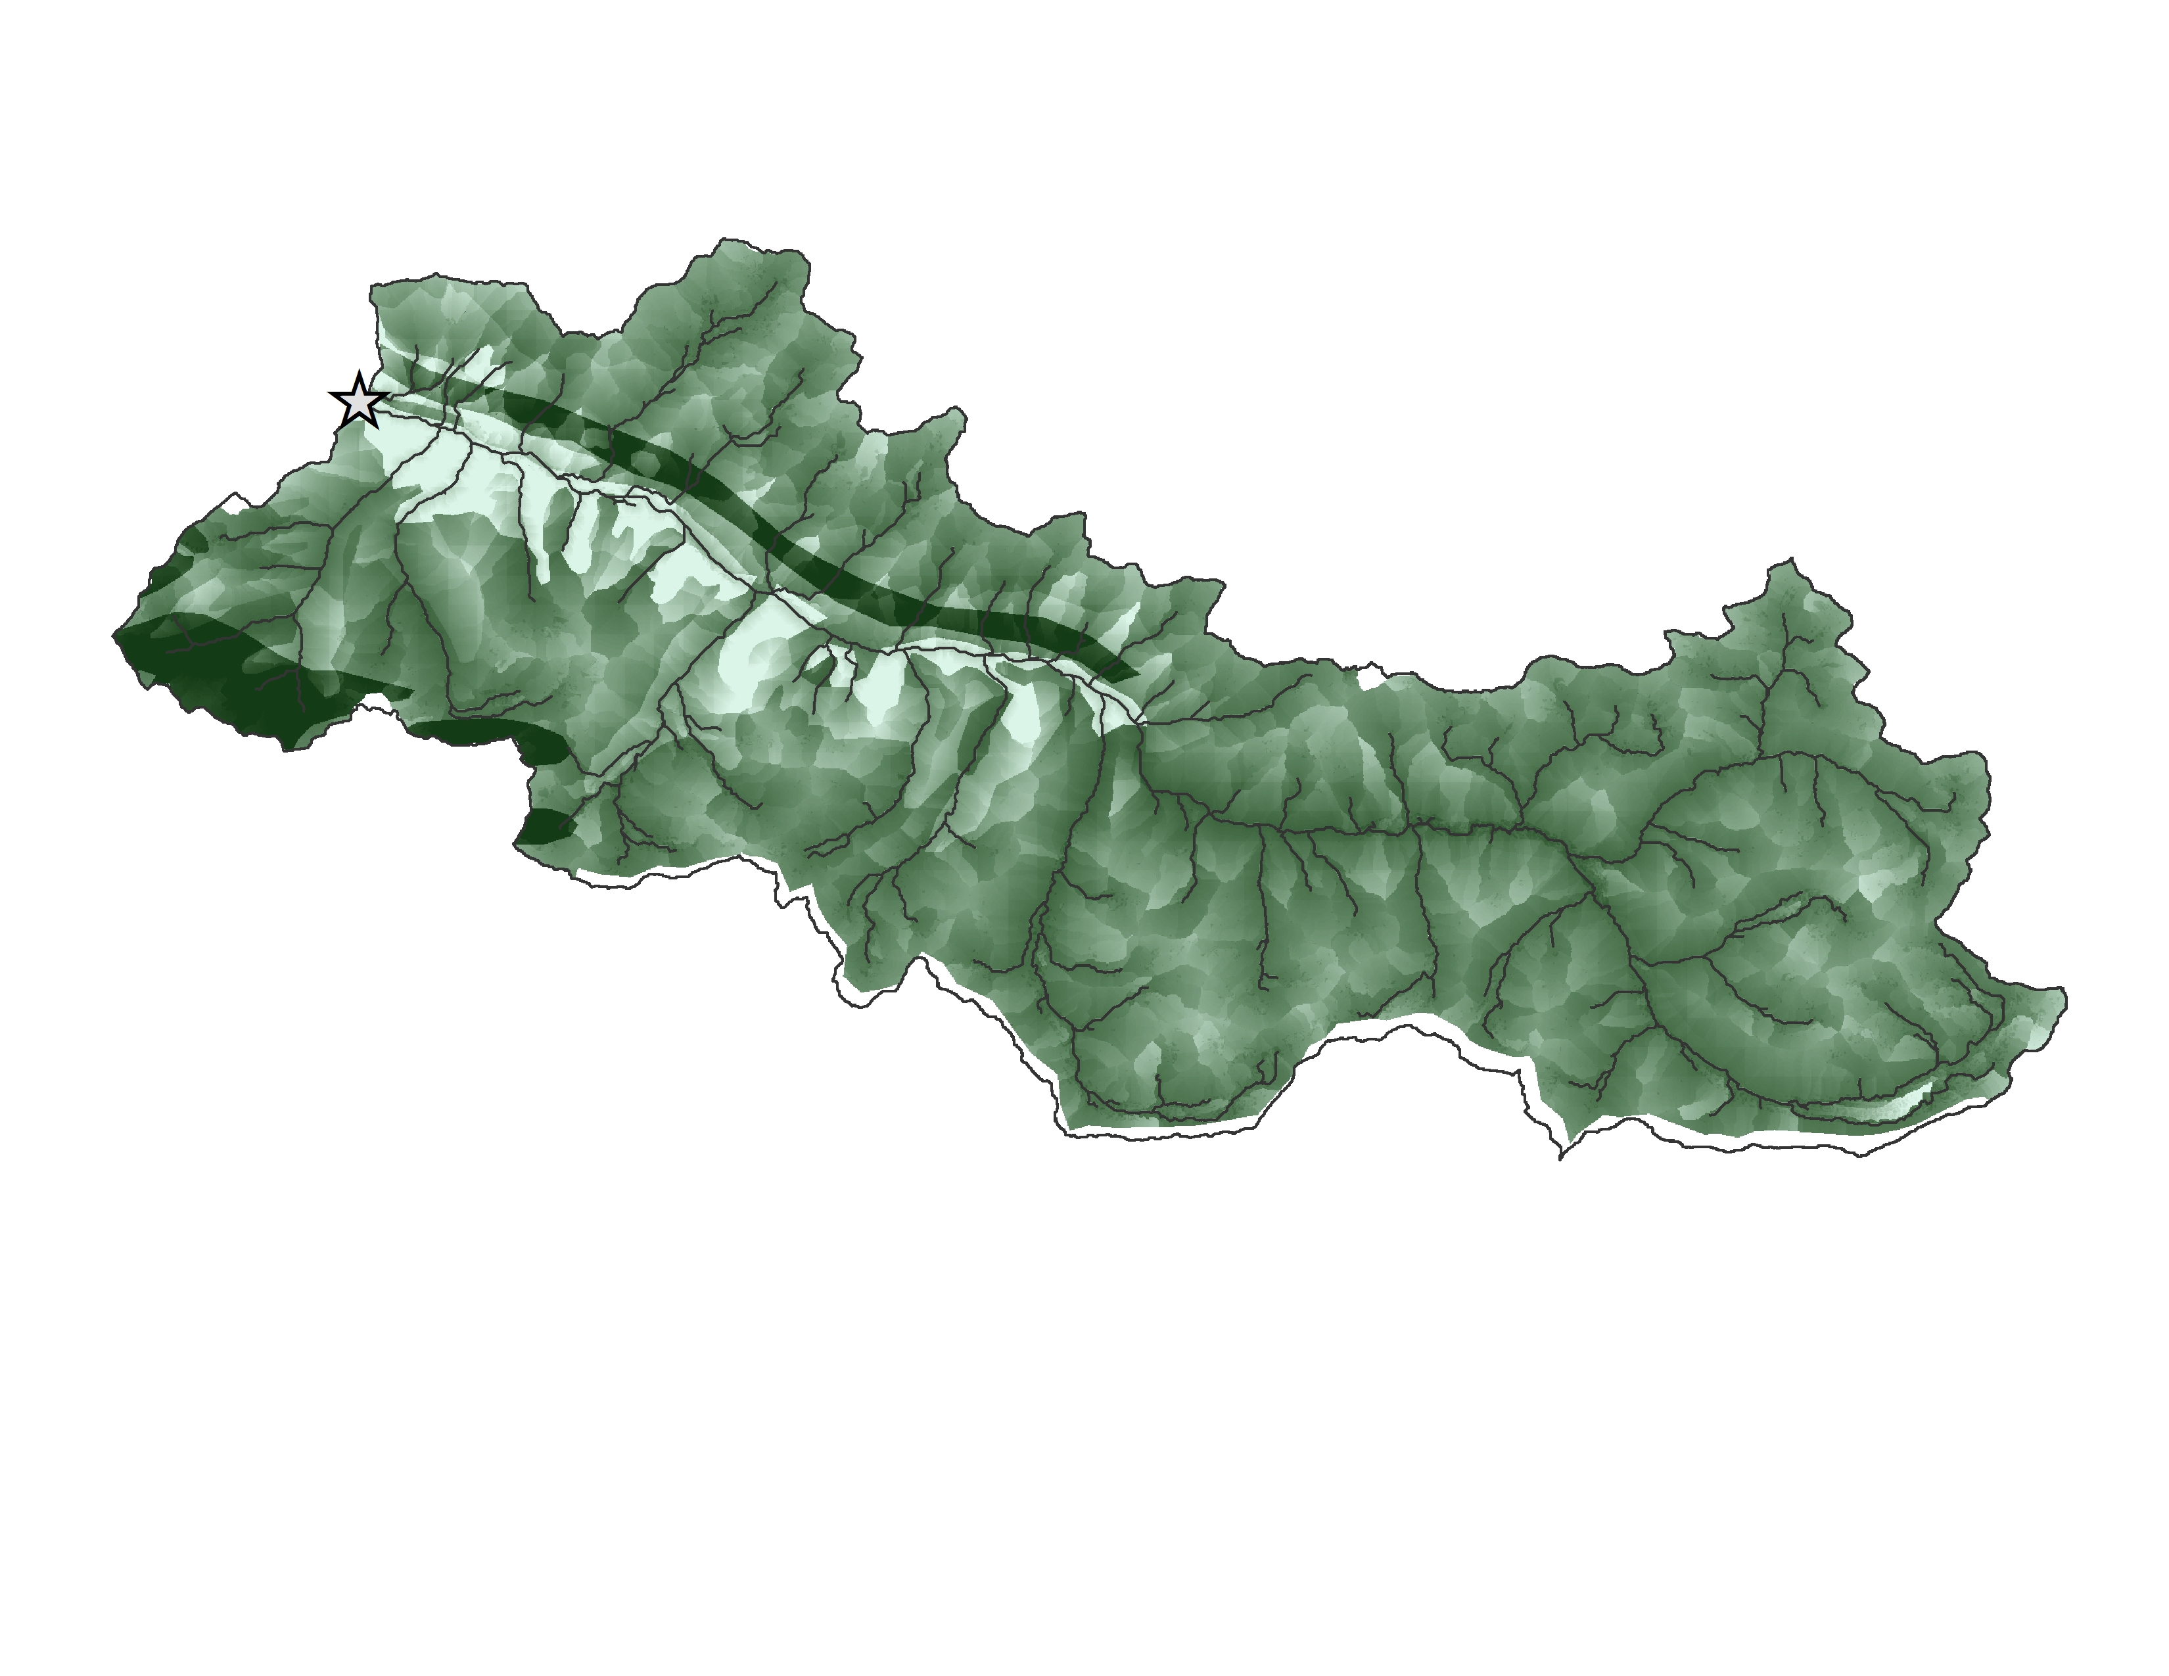
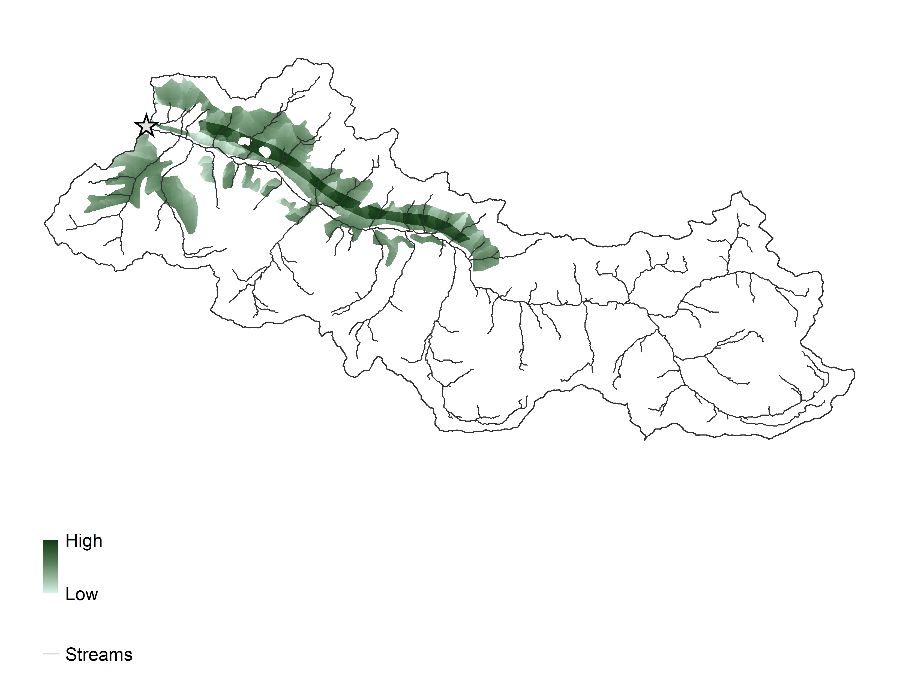
Rios score maps
Baspa – Energy plantation
Score
Ref: Sadrian

Slide 12
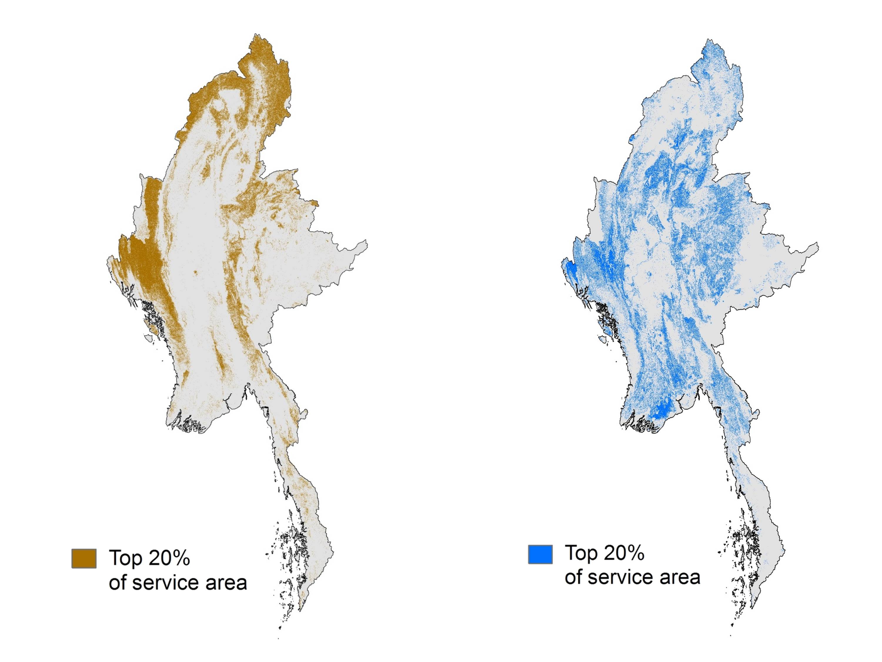
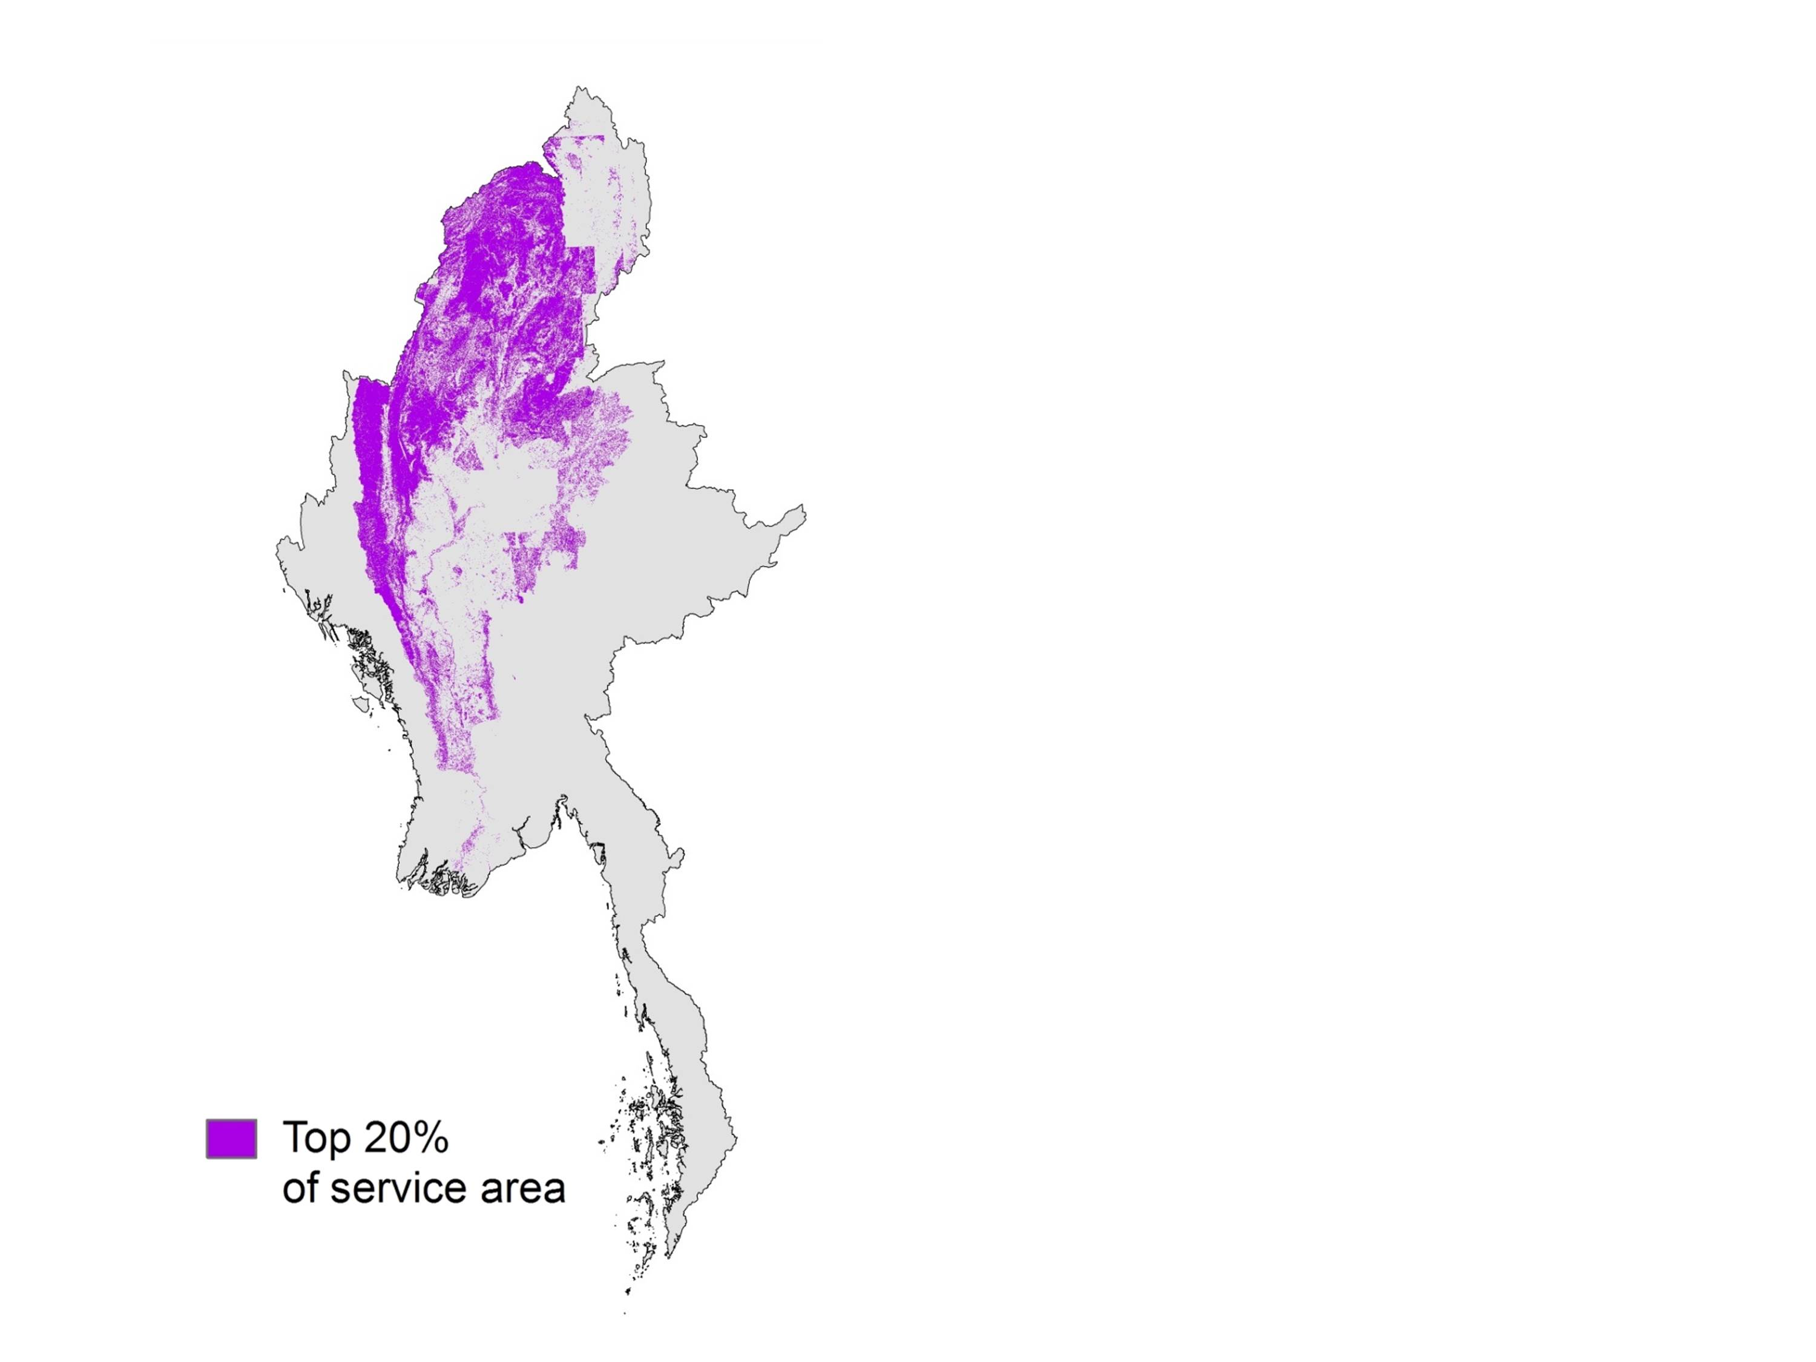
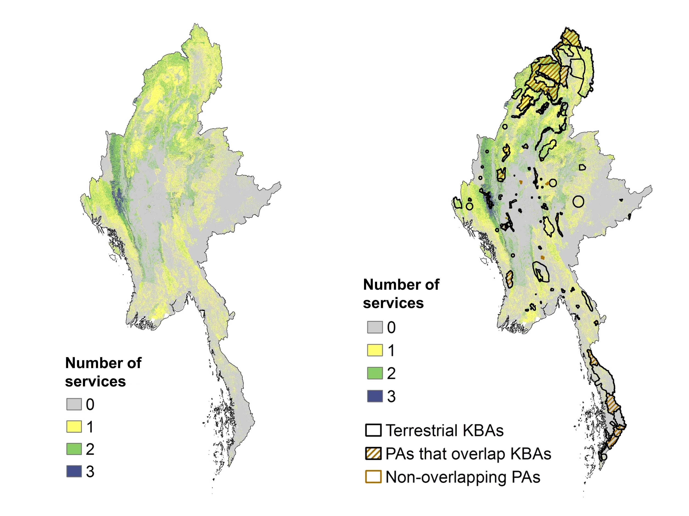
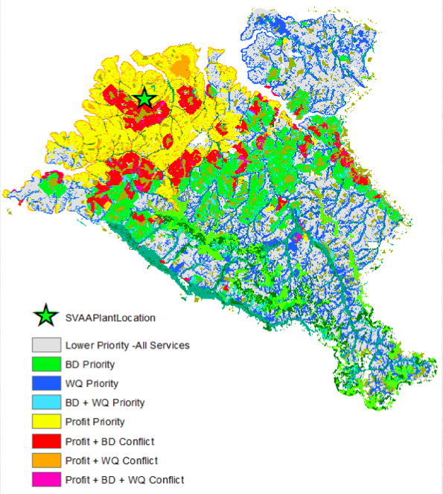
+
+
=
Select the 20% for each service
(a) Continuous hotspot map
(b) Categorical hotspot map

Slide 13
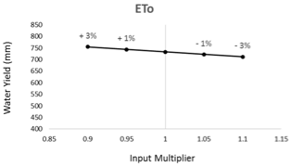
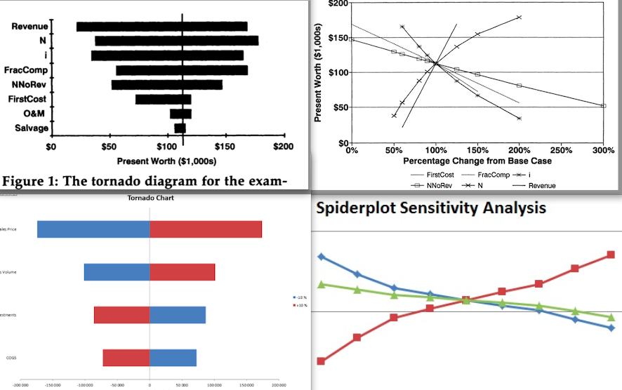
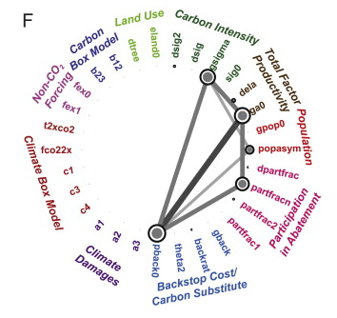
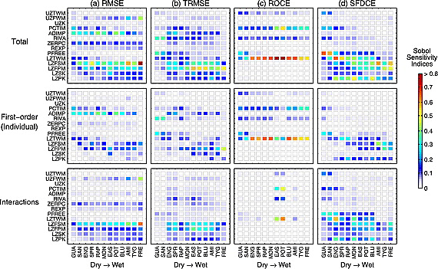
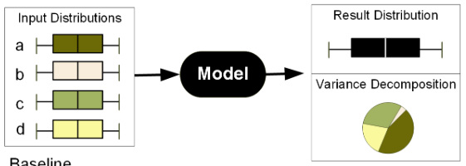
(a) Line chart
(b) Spiderplot
(c) Tornado diagram
(d) Box plots and pie chart
(e) Radial convergence diagram
(f) Pattern plot

Slide 14
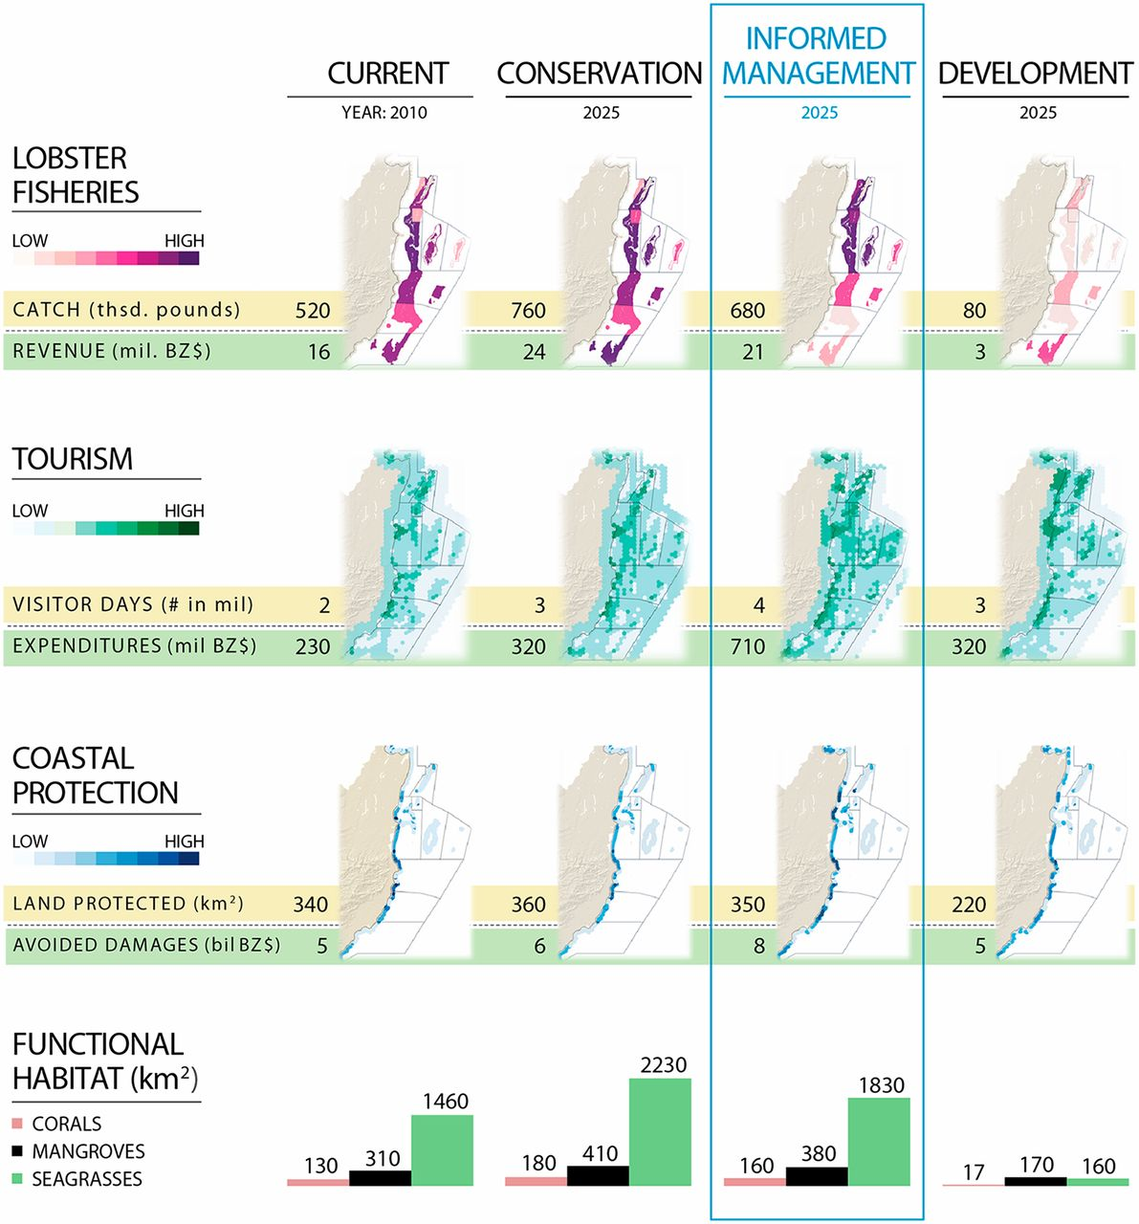
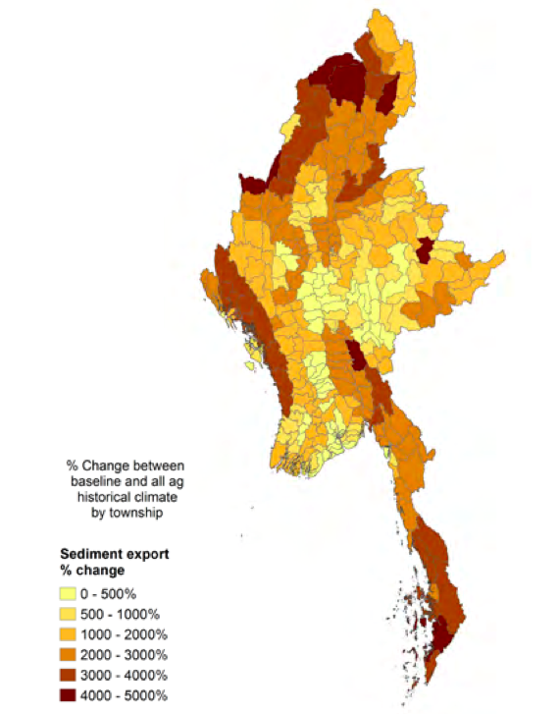
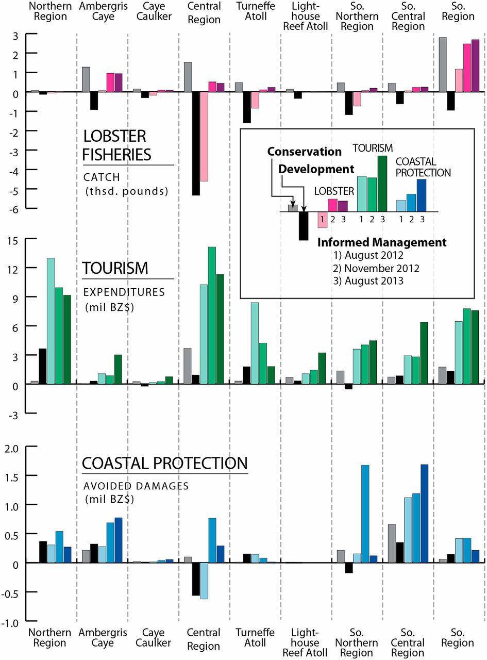
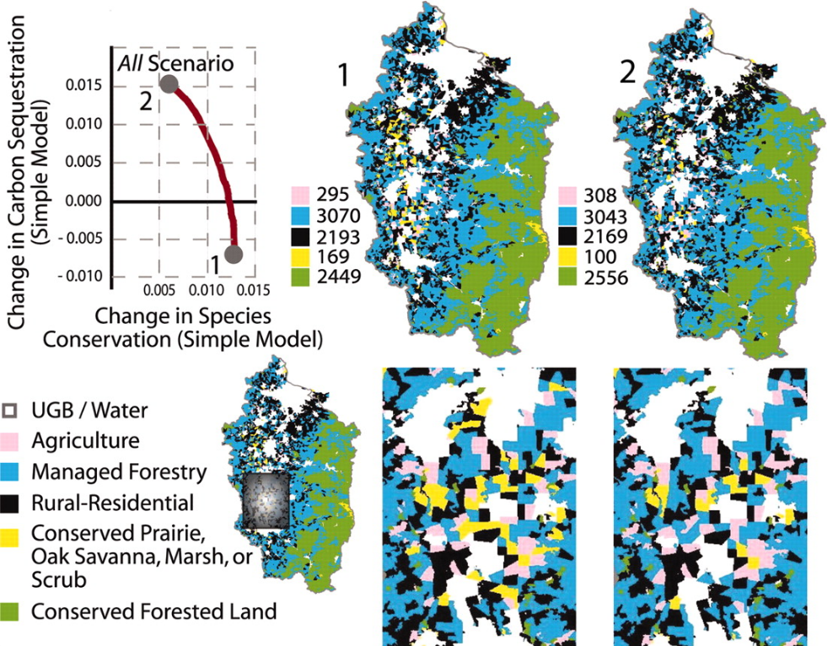
(b) Change map
(a) Map matrix
(c) Multiple views of trade-offs
(d) Small multiples bar plots

Slide 15
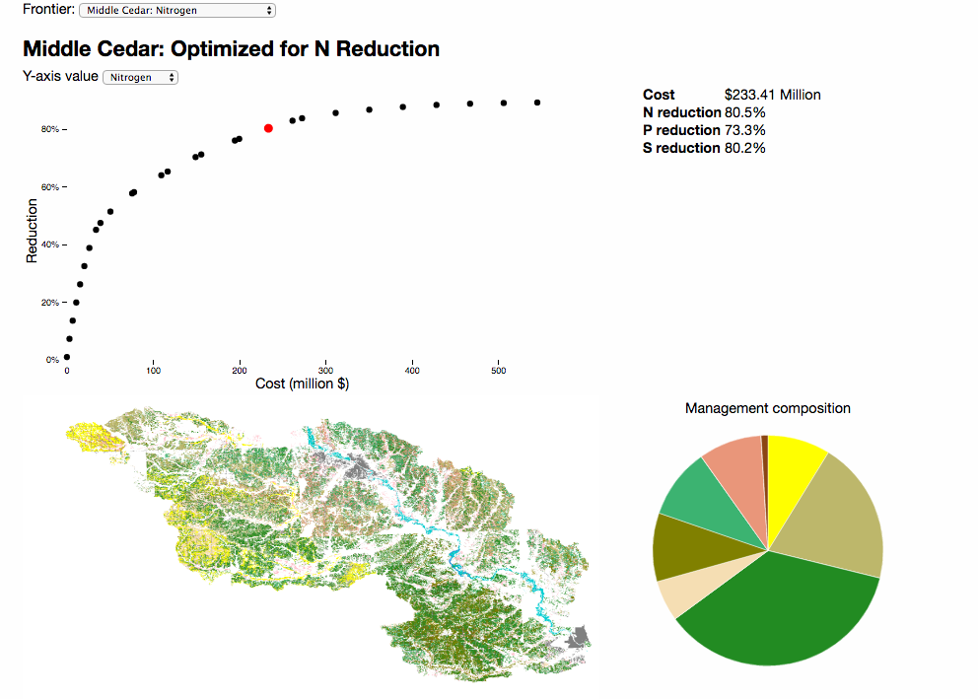
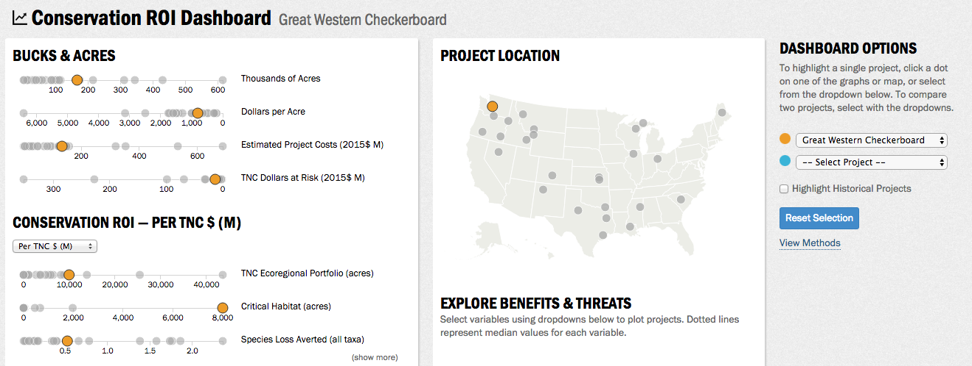

Slide 16
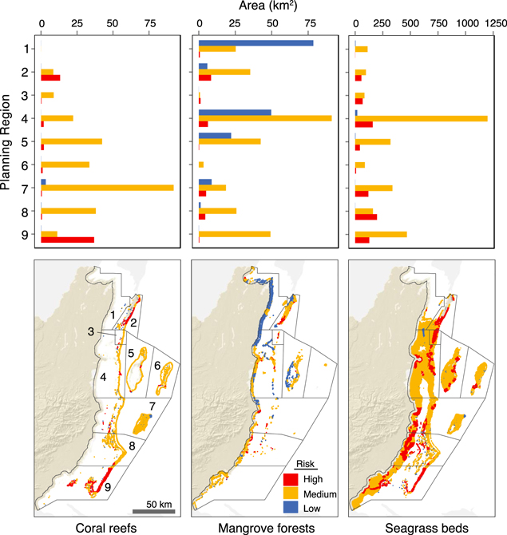
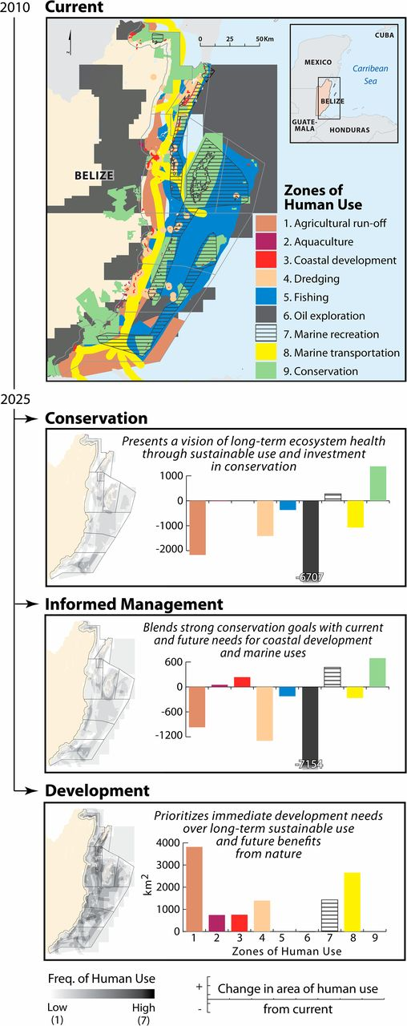
(a) Bar plots, maps and small mutiples
(b) Story-telling approach

Slide 17
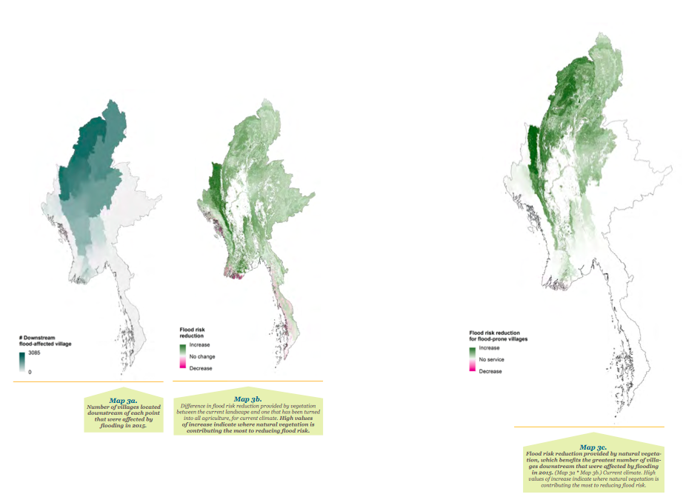
(a)
(b)

Slide 18
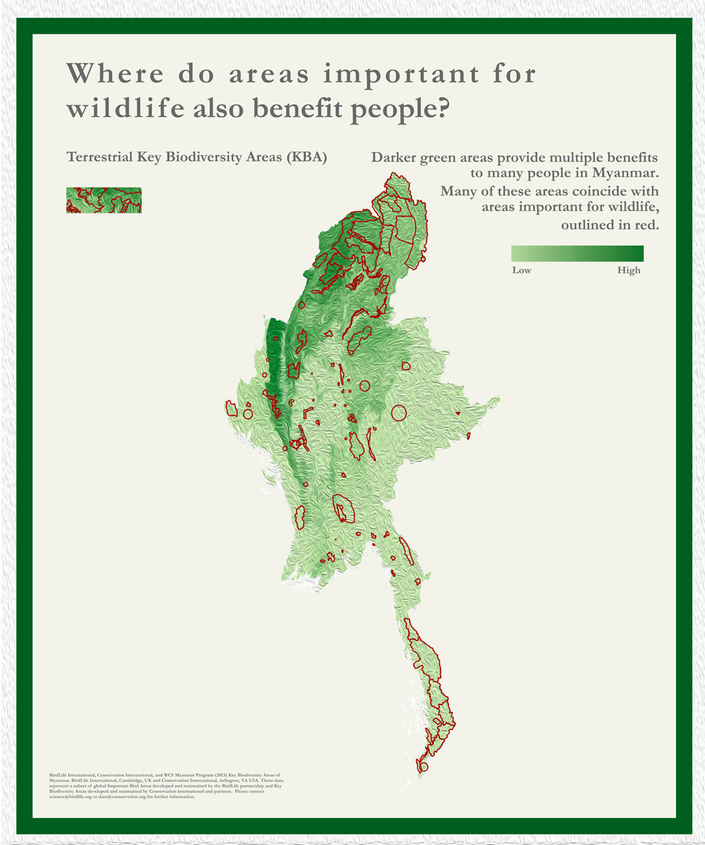
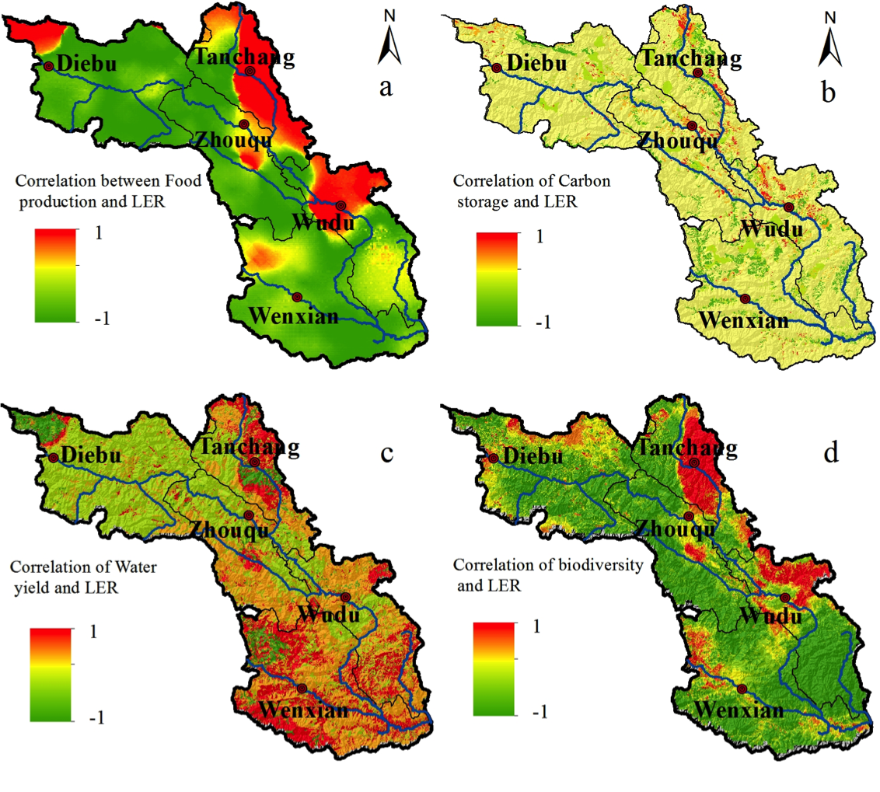
(a) Correlation coefficients
(b) Overlaying

Slide 19
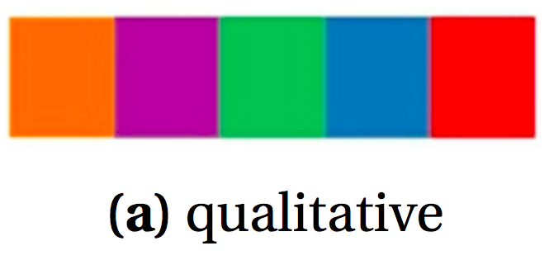
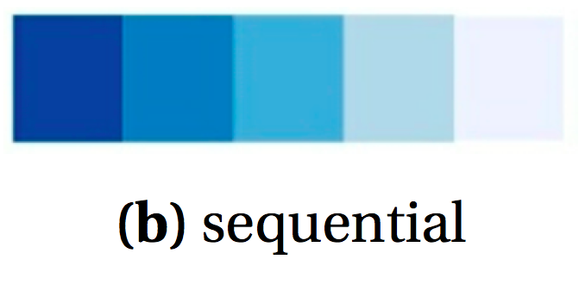
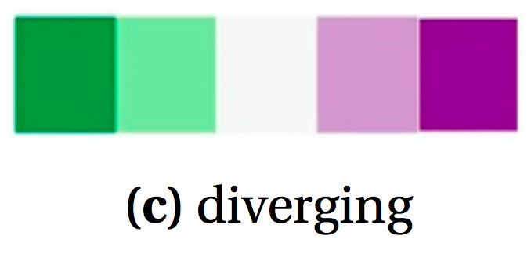

Slide 20
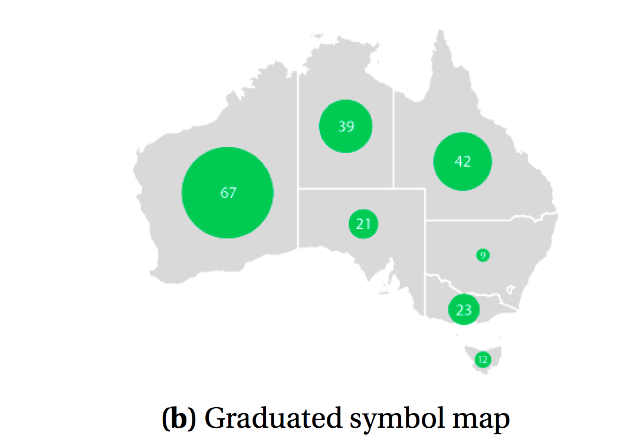
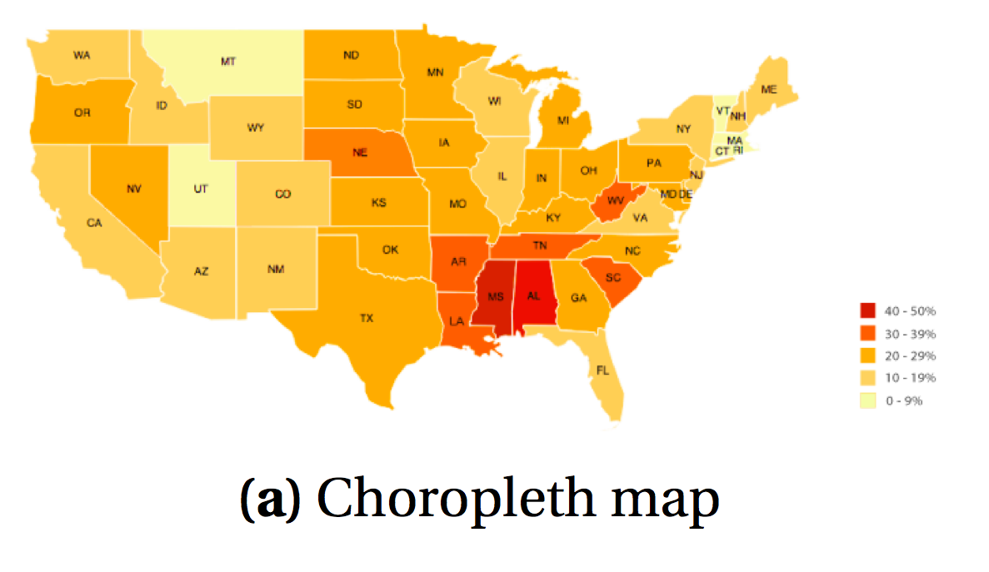
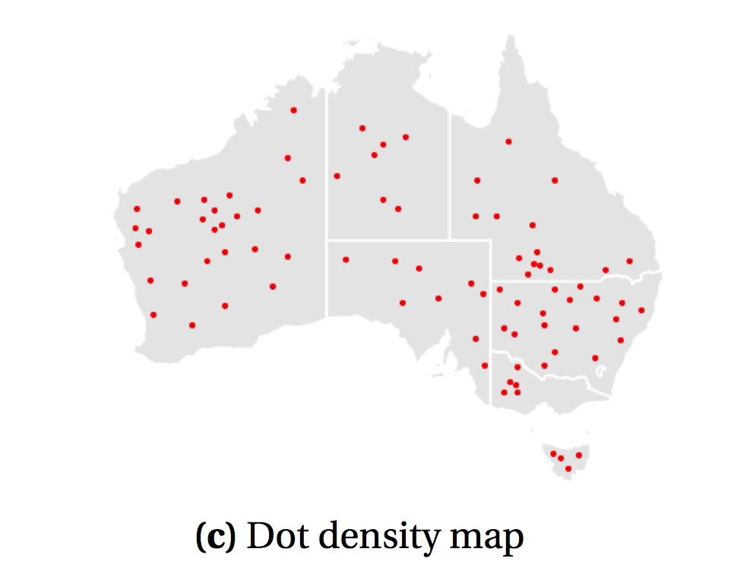
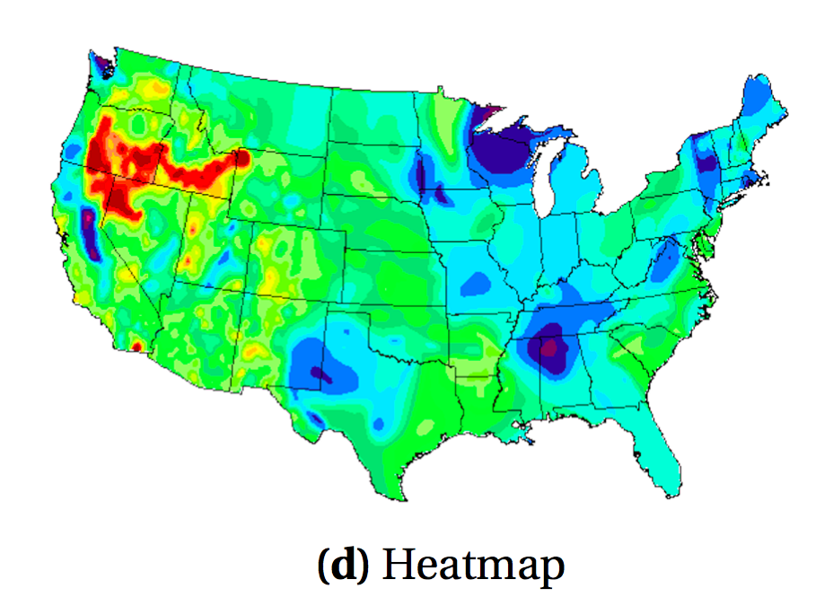

Slide 21
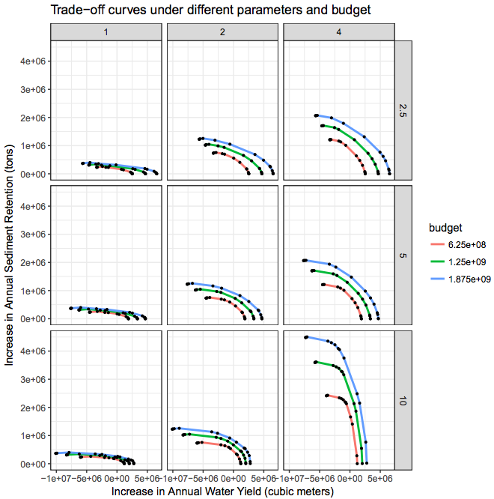
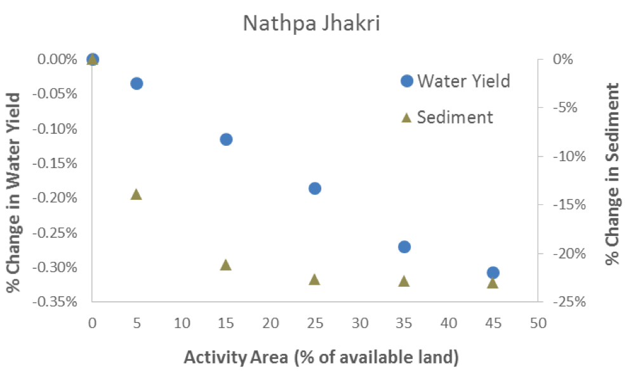
(a) Two axis scatterplot
(b) Small multiples of scatterplots with trade-off curves

